Slide 1

Chronic Kidney Disease Risk Factors
Midpoint Project Presentation
Sade Graves
11/14/2024
Notes:
Delete this slide when you finish preparing the other slides.

Slide 2
objectives
My project objective is to merge two different EHR datasets with similar variable classifications.
Combining the datasets, my goal is to use machine learning models to predict particular risk factors features that can help identify the signs of CKD in patients

Slide 3

Data overview
Task Type
Features / Instances
Target Variable
Classification
My supervised machine learning task is classification due to the dataset’s variables are discrete categories.
Number of Features : 29
Number of instance : 600
The target variables used in my analysis
    Class (CKD or Not CKD)
The class variable defines whether the individual has CKD.
Risk Factors Features (BUN)
The testing of the BUN level asset earlier detection of renal disease.
  BUN testing is usually done before the Serum creatine assessment. High protein, hypertension, gestational bacteria, and urinary tract infections can increase BUN levels.

Slide 4

Models
LOGISTIC REGRESSION
RANDOM FOREST
.
Accuracy | F1 Score | Recall
0.96 | Ckd: 0.95 | Ckd: 0.90
 | NCkd: 0.98 | Nckd:1.00
Accuary | F1 Score | Recall
1.00 | Ckd: 0.49 | Ckd: 1.00
 | Nckd:1.00 | Nckd:1.00
Best Hyperparameters | Best Cross Val Score
C:0.01 | 0.98
Penalty: l2
Solver: liblinear
Max_iter:1000
Best Hyperparameters | Best Cross Val Score
Max Depth: None | 0.992
Mini Samples Leaf: 1
Mini Samples Split:2
N_estimators:50

Slide 5
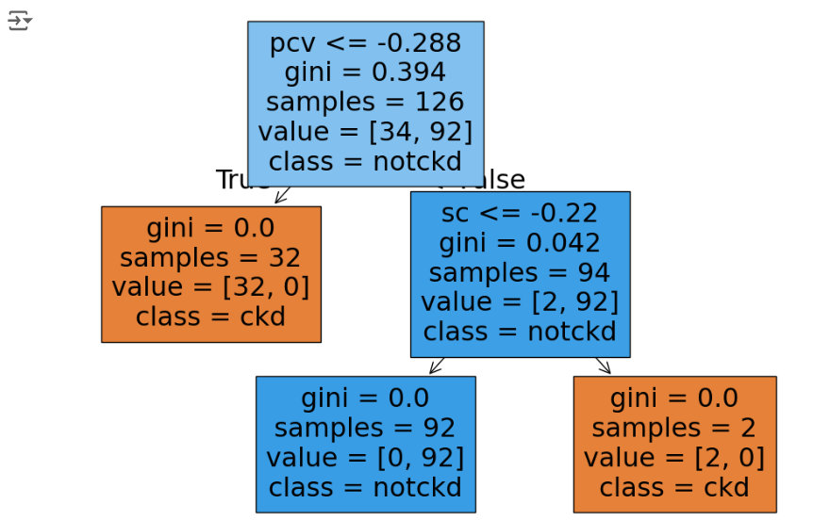
models
DECISION TREE
Accuracy | F1 Score | Recall
1.0 | Ckd: 1.00 | Ckd:1.00
 | Nckd:1.00 | Nckd:1.00
.
Best Parameters | Best Cross Val Score
Criterion: gini | 0.94
Max depth: 3
Mini Samples Leaf: 1
Mini Samples Split:2
Decision tree for predicting chronic kidney disease (CKD). The model primarily uses specific gravity (sg) and blood urea nitrogen (bu) to classify patients. Patients with sg ≤ 1.019 and bu ≤ 66 tend to be classified as not having CKD (notckd), while those with higher values for either feature are more likely to be classified as having CKD (ckd)

Slide 6
ModelS
SVM
ADA Boost
.
Accuracy | F1 Score | Recall
0.96 | Ckd: 0.94 | Ckd:0.88
 | Nckd:0.98 | Nckd:1.00
Accuracy | F1 Score | Recall
0.98 (Train) | Ckd/nckd:0.94/ 0.98 | Ckd/ Nckd: 0.89/1.00
Best Parameters | Cross Val Score
C: 0.1 | 0.906
Kernel: Linear
Gamma: scale
Degree: 2
Best Parameters | Cross Val Score
Algorithms : Samme | 1.00
Learning Rate: 0.1
Estimator: 50

Slide 7
ModelS
XGM Boost
LightGBM
.
Accuracy | F1 Score | Recall
0.98 | Ckd: 0.96 | Ckd:0.92
 | Nckd:0.99 | Nckd:1.00
Accuracy | F1 Score | Recall
0.97 | Ckd/nckd: 0.96/0.99 | Ckd/ Nckd: 0.92/1.00
Best Parameters | Cross Val Score
Col sample-by tree:0.8 | 0.98
Learning rate:0.01
Max depth: 3
Nestimator:1.00
Sub sample: 0.8
Best Parameters | Cross Val Score
Learning rate:0.01 | 0.98
Max depth:3
N_estimator : 100
Num _leaves: 31

Slide 8
Final Evaluation Table
Models |  | Logistic | Decision Tree | Random Forest | SVM | ADA Boost | XGBoost | Light GBM
Accuracy |  | 0.96 | 0.99 | 1.00 | 0.98 | 0.98 | 0.99 | 0.98
F1 Score |  | CKD= 0.94 NOTCKD= 1.00 | CKD=0.94 NOTCKD= 98 | CKD= 1.00 NOTCKD= 1.00 | CKD= 1.00 NOTCKD= 1.00 | CKD=0.96 NCKD=0.99 | CKd=0.96 NCKd=1.00 | Ckd:0.96 NCKd:0.99
Sensitivity (Recall) |  | CKD= 0.89 NOTCKD=1.00 | CKD= 0.89 NOTCKD= 1.00 | CKD=1.00 NOTCKD=1.00 | CKD=1.00 NCKd+1.00 | CKD=0.92 NCKd=1.00 | CKd=0.98 NCKd=0.99 | Ckd:0.92 NCkd1.00
Specificity |  | 0.9 | 0.88 | 0.992 | 1.00 | 0.92 | 0.96 | 0.94

Slide 9
Summary
purpose is to develop a predictive model for chronic kidney disease using a dataset of patient features with the goal of accurately classifying individuals as having CKD or not having CKD. This prediction can be valuable for early diagnosis and treatment planning.
After Recommend dation from my Professor , DR. Saha I drop the Serum Creatine feature from model . In order tot reveal the difference I input the ‘new values in my final evacuation table.

